Slide 1


FLARE-F1 CAPSTONE PROJECT
BY
STEVEN TODD

Slide 2


THIS IS JUST A TRIBUTE

Slide 3
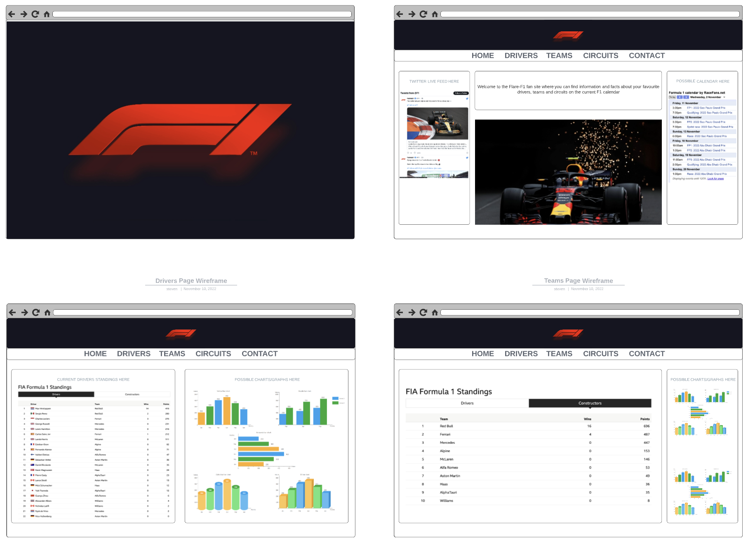
Landing Page
Live Twitter Feed
Race Calendar
Charts
News Blog Item
Country Icons (flags)
Contact Us Form

Slide 4
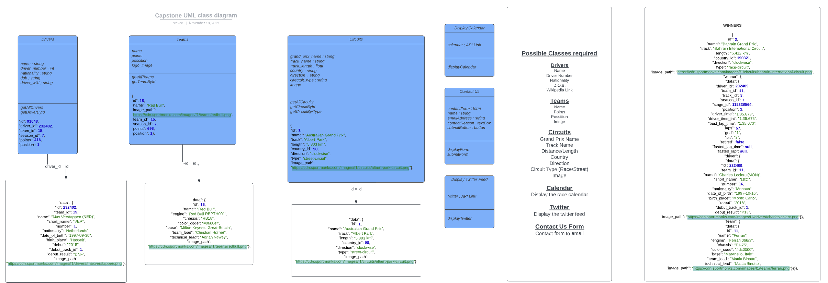
DATA DATA DATA!!!
14 inter-connected SQL tables

Slide 5
MVP
Landing page with main logo only which is clickable to the “Home Page”
“Home Page” – Nav bar, logo, news article and footer
Nav Bar – Home – Drivers – Teams – Circuits
The site will use MaterialUI for design and include components such as a search bar for driver, circuit and team information
Each link in the nav bar will go to a main page for that relevant subject with a series of statistics relevant to each chosen subject displayed on the page in a table Statistics shown in graph form as well as the table layout
Interactive car to show information regarding the main components of an F1 car

Slide 6
CHALLENGES
TIME
SOLO WORKING
POPOVERS!!!
GRID LAYOUT
SEARCHBAR
DATA, DATA, DATA

Slide 7
WISH LIST
SEARCHBAR
SVG CHARTS
TWITTER FEED
CALENDAR
SSO LOGIN TO ALLOW PERSONALIZATION
DRIVER CARDS – TOP TRUMPS STYLE

Slide 8

COOL COOL….DUH, DUUHHH, DAAAA - ALEX
TO THE “FANCY”, LETTUCE COACH THAT IS JOHN
I DON’T LIKE TO TALK MEERA
THE QUIETLY BRILLIANT JACK
F#!@ A DUCK STUART
THE ENTIRE COHORT OF E60 AWESOMENESS

